Slide 1
Addressing Modes
Department of Computer Science & Engineering
Pandit Deendayal Energy University, Gandhinagar

Slide 2
Memory Stack Organization in Computer Architecture
A stack is a storage device in which the information or item stored last is retrieved first. Basically, a computer system follows a memory stack organization.
A portion of memory is assigned to a stack operation to implement the stack in the CPU.
The processor register is used as a Stack Pointer (SP).
Program Counter (PC): It is a register that points to the address of the next instruction that is going to be executed in the program.
Address Register (AR): This register points at the collection of data and is used during the execute phase to read an operand.
Stack Pointer (SP): It points at the top of the stack and is used to push or pop the data items in or from the stack.

Slide 3
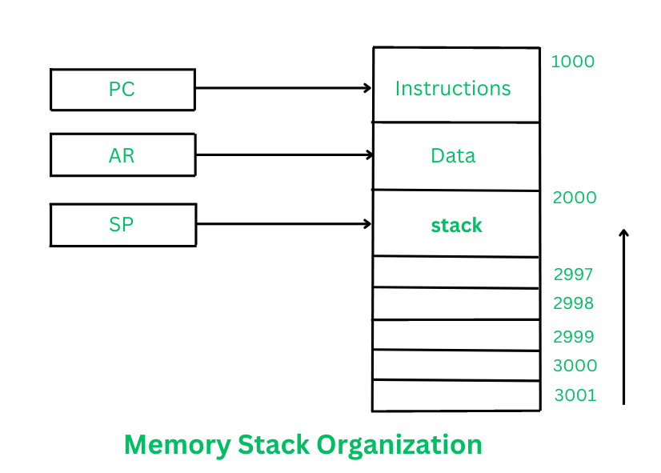
Memory Stack Organization in Computer Architecture

Slide 4
Memory Stack Organization in Computer Architecture
Stack Pointer is first going to point at the address 3001, and then the stack will grow with the decreasing addresses.
It means that the first item is going to be stored at address 3001, the second item at address 3000, and the items can keep getting stored in the stack until it reaches the last address 2000 where the last item will be held.
Here the data which is getting inserted into the Stack is obtained from the Data Register and the data retrieved from the Stack is also read by the Data Register.

Slide 5
Memory Stack Organization in Computer Architecture
PUSH
This operation is used to insert a new data item into the top of the Stack. The new item can be inserted as follows:-
SP ←SP-1
M[SP]← DR
In the first step, the Stack Pointer is decremented to point at the address where the data item will be stored.
Then, by using the memory write operation, the data item from Data Register gets inserted into the top of the stack

Slide 6
Memory Stack Organization in Computer Architecture
POP
This operation is used to delete a data item from the top of the Stack. Data item can be deleted as follows:-
DR←M[SP]
SP←SP+1
In the first step, the top data item is read from the Stack into the Data Register. The Stack Pointer is then incremented to point at the next data item in the stack.
Push or Pop operations can be performed with the help of the following microoperations:
Access to memory with the help of Stack Pointer (SP), and
Updating the stack.

Slide 7
Advantages of Stack Memory
It helps us to manage the data in a Last In First Out(LIFO) method which is not possible with a Linked list and array.
When a function is called the local variables are stored in a stack, and it is automatically deallocated once returned.
A stack is used when a variable is not used outside that function.
It allows you to control how memory is allocated and deallocated.
Stack automatically cleans up the object.
It is not easily corrupted.
Variables that are declared once cannot be resized.

Slide 8
Disadvantages of Stack Memory
Stack memory is very limited.
Random access is not possible.
Creating too many objects on the stack can increase the risk of stack overflow.
Variable storage will be overwritten, which sometimes leads to undefined behavior of the function or program.
The stack will fall outside of the memory area, which might lead to an abnormal termination.

Slide 9
Addressing Modes
Operand, Operator and Opcode
Operands are the objects that are manipulated and operators are the symbols that represent specific actions.
For example, in the expression x + 5, x and 5 are operands and + is an operator.
Opcode is an instruction that tells processor what to do with the variable or data written besides it.
For Example: ADD R1,R2
ADD is the Opcode and R1 and R2 are the Operand.

Slide 10
Addressing Modes
The term addressing modes refers to the way in which the operand of an instruction is specified. The addressing mode specifies a rule for interpreting or modifying the address field of the instruction before the operand is actually executed.
The operands of the instructions can be located either in the main memory or in the CPU registers. If the operand is placed in the main memory, then the instruction provides the location address in the operand field.
Many methods are followed to specify the operand address.
The different methods/modes for specifying the operand address in the instructions are known as addressing modes.

Slide 11
Addressing Modes
The control unit is designed to go through an instruction cycle that is divided into three major phases:
Fetch the instruction
Decode the instruction
Execute the instruction
There is one register called Program Counter (PC) that keeps track of the instructions in the program stored in memory.
An example of an instruction format with a distinct addressing mode field is shown in following figure:
Opcode | Mode | Address

Slide 12
Types of Addressing Modes
Implied / Implicit Addressing Mode
Stack Addressing Mode
Immediate Addressing Mode
Direct Addressing Mode
Indirect Addressing Mode
Register Direct Addressing Mode
Register Indirect Addressing Mode
Relative Addressing Mode
Indexed Addressing Mode
Base Register Addressing Mode
Auto-Increment Addressing Mode
Auto-Decrement Addressing Mode

Slide 13
1.Implied Addressing Mode
In this addressing mode
The definition of the instruction itself specify the operands implicitly.
It is also called as implicit addressing mode.
Examples-
The instruction “Complement Accumulator” is an implied mode instruction.
In a stack organized computer, Zero Address Instructions are implied mode instructions. (since operands are always implied to be present on the top of the stack)

Slide 14
2.Stack Addressing Mode
In this addressing mode,
The operand is contained at the top of the stack.
Examples- ADD
This instruction simply pops out two symbols contained at the top of the stack.
The addition of those two operands is performed.
The result so obtained after addition is pushed again at the top of the stack.

Slide 15
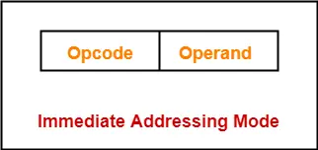
3.Immediate Addressing Mode
In this addressing mode,
The operand is specified in the instruction explicitly.
Instead of address field, an operand field is present that contains the operand.
Examples- ADD
ADD 10 will increment the value stored in the accumulator by 10.
MOV R #20 initializes register R to a constant value 20.
No memory reference to fetch data, Fast, Limited range

Slide 16
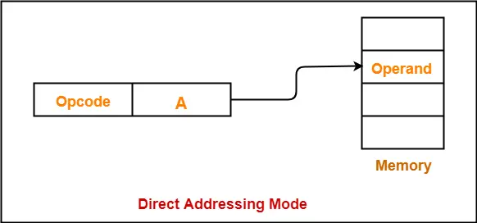
4.Direct Addressing Mode
In this addressing mode
The address field of the instruction contains the effective address of the operand.
Only one reference to memory is required to fetch the operand.
It is also called as absolute addressing mode.
Examples:
ADD X will increment the value stored in the accumulator by the value stored at memory location X.
AC ← AC + [X]

Slide 17
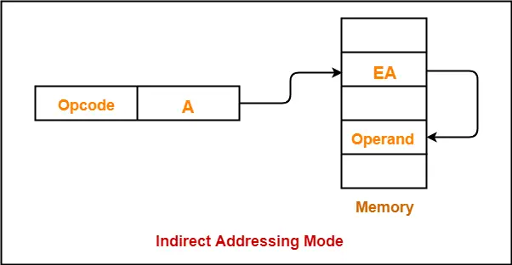
5.Indirect Addressing Mode
In this addressing mode
The address field of the instruction specifies the address of memory location that contains the effective address of the operand.
Two references to memory are required to fetch the operand.
Examples:
ADD X will increment the value stored in the accumulator by the value stored at memory location specified by X.
AC ← AC + [[X]]

Slide 18
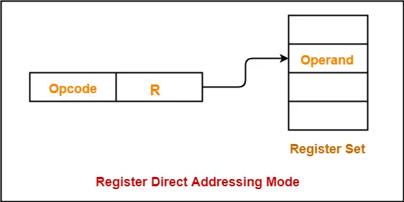
6.Register Direct Addressing Mode
In this addressing mode
The operand is contained in a register set.
The address field of the instruction refers to a CPU register that contains the operand.
Examples:
ADD R will increment the value stored in the accumulator by the content of register R.
AC ← AC + [R]
This addressing mode is similar to direct addressing mode.
The only difference is address field of the instruction refers to a CPU register instead of main memory.

Slide 19
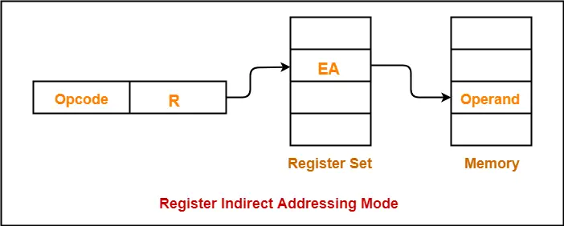
7. Register Indirect Addressing Mode
In this addressing mode
The address field of the instruction refers to a CPU register that contains the effective address of the operand.
Only one reference to memory is required to fetch the operand.
Examples:
ADD R will increment the value stored in the accumulator by the content of memory location specified in register R.
This addressing mode is similar to indirect addressing mode.
The only difference is address field of the instruction refers to a CPU register.

Slide 20
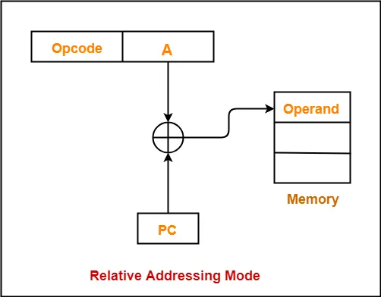
8. Relative Addressing Mode
In this addressing mode
Effective address of the operand is obtained by adding the content of program counter with the address part of the instruction.
Program counter (PC) always contains the address of the next instruction to be executed.
After fetching the address of the instruction, the value of program counter immediately increases.
The value increases irrespective of whether the fetched instruction has completely executed or not.

Slide 21
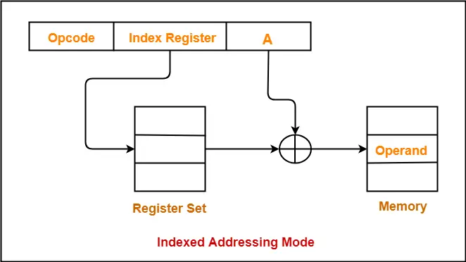
9. Indexed Addressing Mode
In this addressing mode
Effective address of the operand is obtained by adding the content of index register with the address part of the instruction.

Slide 22
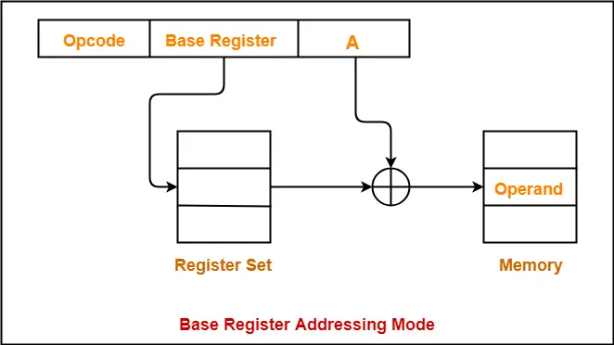
10. Base Register Addressing Mode
In this addressing mode
Effective address of the operand is obtained by adding the content of base register with the address part of the instruction.

Slide 23
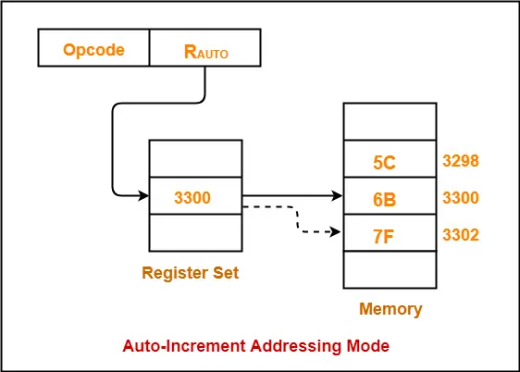
11. Auto-Increment Addressing Mode
In this addressing mode
After accessing the operand, the content of the register is automatically incremented by step size ‘d’.
Step size ‘d’ depends on the size of operand accessed.
Only one reference to memory is required to fetch the operand.
Assume operand size = 2 bytes.
Here,
After fetching the operand 6B, the instruction register R_{AUTO} will be automatically incremented by 2.
Then, updated value of R_{AUTO} will be 3300 + 2 = 3302.
At memory address 3302, the next operand will be found.

Slide 24
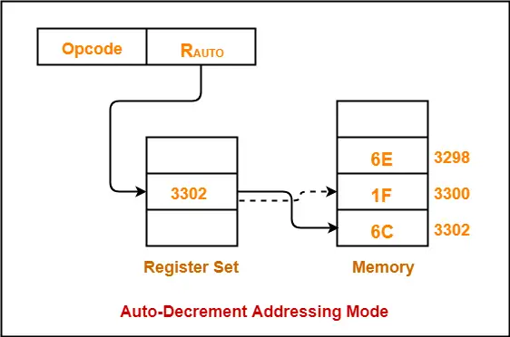
12. Auto-Decrement Addressing Mode
In this addressing mode
First, the content of the register is decremented by step size ‘d’.
Step size ‘d’ depends on the size of operand accessed.
After decrementing, the operand is read.
Only one reference to memory is required to fetch the operand.
Assume operand size = 2 bytes.
Here,
First, the instruction register R_{AUTO} will be decremented by 2.
Then, updated value of R_{AUTO} will be 3302 – 2 = 3300.
At memory address 3300, the operand will be found.

Slide 25
Applications of Addressing Modes
Addressing Modes | Applications
Immediate Addressing Mode | To initialize registers to a constant value
Direct Addressing Mode and Register Direct Addressing Mode | To access static data To implement variables
Indirect Addressing Mode and Register Indirect Addressing Mode | To implement pointers because pointers are memory locations that store the address of another variable To pass array as a parameter because array name is the base address and pointer is needed to point the address
Relative Addressing Mode | For program relocation at run time i.e. for position independent code To change the normal sequence of execution of instructions For branch type instructions since it directly updates the program counter

Slide 26
Applications of Addressing Modes
Addressing Modes | Applications
Index Addressing Mode | For array implementation or array addressing For records implementation
Base Register Addressing Mode | For writing relocatable code i.e. for relocation of program in memory even at run time For handling recursive procedures
Auto-increment Addressing Mode and Auto-decrement Addressing Mode | For implementing loops For stepping through arrays in a loop For implementing a stack as push and pop

Slide 27
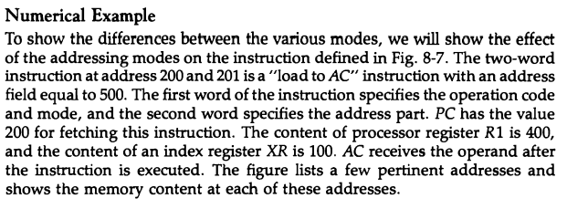
Addressing Modes Example

Slide 28
Addressing Modes Example

Slide 29
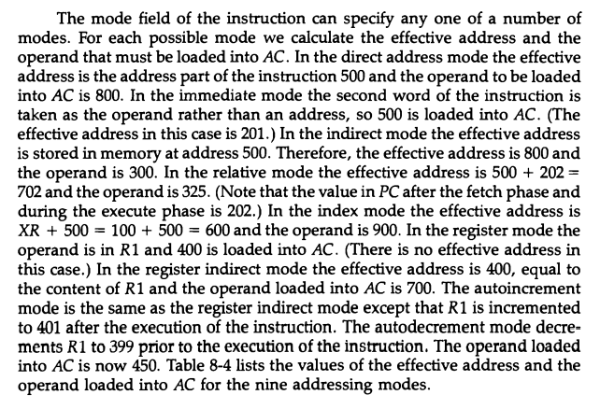
Addressing Modes Example

Slide 30
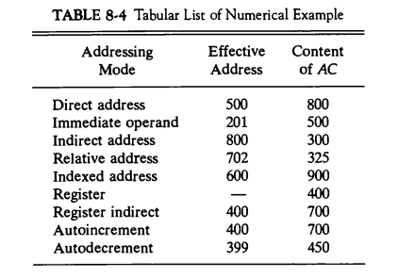
Addressing Modes Example

